Slide 1
AWS CloudFront
Content Delivery Network (CDN)
Popular CDN Services
What is AWS CloudFront

Slide 2
Content Delivery Network (CDN)
A content delivery network (CDN) refers to a geographically distributed group of servers which work together to provide fast delivery of Internet content.
A CDN allows for the quick transfer/loading of Internet content including HTML pages, javascript files, images, and videos.
The CDN services continues to grow, and today the majority of web traffic is served through CDNs, including traffic from major sites like Facebook, Netflix, and Amazon
Benefits of using a CDN
Improving website load times
Reducing bandwidth costs
Increasing content availability and redundancy
Improving website security

Slide 3
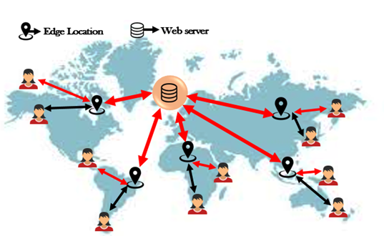

Slide 4
Popular CDN Services
Cloudflare CDN
Akamai CDN
Amazon CloudFront
Microsoft Azure CDN
Google Cloud CDN
Alibaba Cloud CDN
Imperva Cloud Application Security
Rackspace CDN
Fastly CDN
CDN77 CDN

Slide 5
What is AWS CloudFront
Amazon CloudFront is a fast content delivery network (CDN) service that securely delivers data, videos, applications, and APIs to customers globally with low latency, high transfer speeds, all within a developer-friendly environment.
Use cases
Deliver fast, secure websites
Accelerate dynamic content delivery and APIs
Stream live and on-demand video
Distribute patches and updates

Slide 6
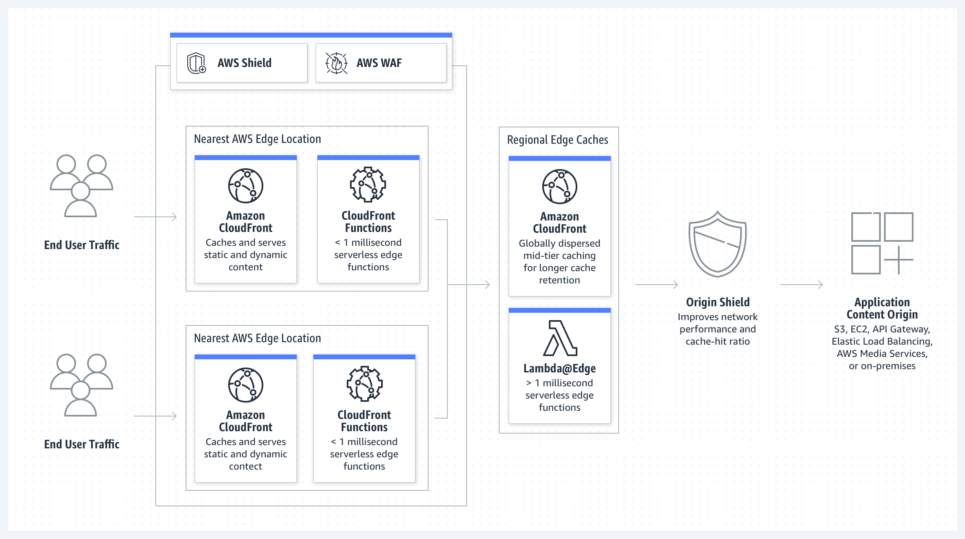

Slide 7
AWS CloudFront
CloudFront is a global (not regional) service.
Amazon CloudFront is a web service that speeds up distribution of your static and dynamic web content, such as .html, .css, .js, and image and video files.
CloudFront delivers your content through a network of data centers called Edge Locations.
When a user requests content that you're serving with CloudFront, the user is routed to the edge location that provides the lowest latency.
Amazon CloudFront has added several regional edge cache locations globally.
DDoS protection, integration with Shield, AWS Web Application Firewall

Slide 8
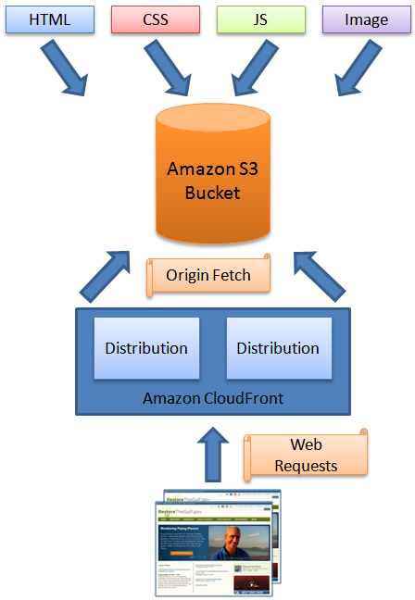
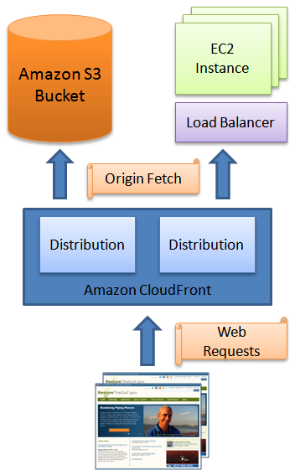

Slide 9
CloudFront Origins
An origin is the location where you store the original web content, which you want to distribute via CloudFront
S3 bucket
For distributing files and caching them at the edge
Enhanced security with CloudFront Origin Access Identity (OAI)
Custom Origin (HTTP)
Application Load Balancer
EC2 instance
S3 website (must first enable the bucket as a static S3 website)
Any HTTP backend you want

Slide 10
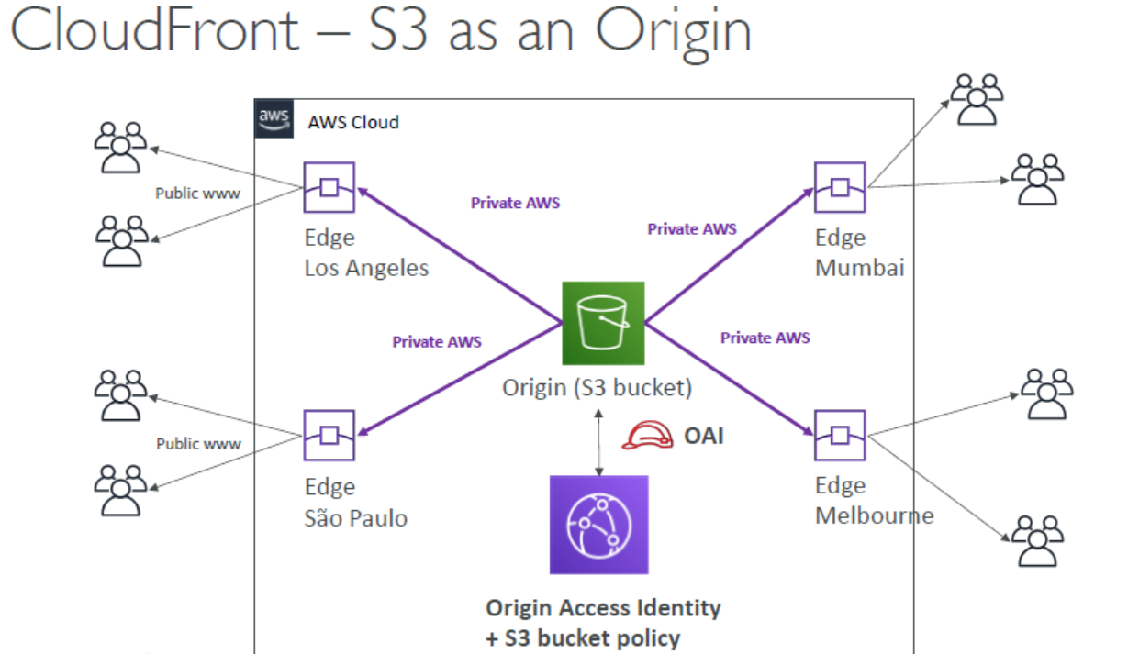

Slide 11
Amazon CloudFront Distributions
Web Distributions: serve the following content over HTTP or HTTPS:
Static and dynamic download content, for example, .html, .css, .js, and image files, using HTTP or HTTPS.
Multimedia content on demand using progressive download and Apple HTTP Live Streaming (HLS).
Your origin can be either an Amazon S3 bucket or an HTTP server
RTMP distributions
Stream media files using Adobe Media Server and the Adobe Real-Time Messaging Protocol (RTMP).
An RTMP distribution must use an Amazon S3 bucket as the origin.
CloudFront lets you create a total of up to 200 web distributions and 100 RTMP distributions for an AWS account.

Slide 12
CloudFront Invalidation
If you need to remove/update an object from CloudFront edge caches before it expires, you can do one of the following:
Invalidate the object from edge caches. The next time a viewer requests the object, CloudFront returns to the origin to fetch the latest version of the object.
Use object versioning to serve a different version of the object that has a different name.
You can't cancel an invalidation after you submit it.
You can invalidate most types of objects that are served by a web distribution
You cannot invalidate media files in the Microsoft Smooth Streaming format when you have enabled Smooth Streaming for the corresponding cache behavior.

Slide 13
Geographic Restrictions
You can use geo restriction, also known as geo-blocking, to prevent users in specific geographic locations from accessing content that you're distributing through a CloudFront web distribution.
Restriction type
No restrictions
Allow list
Block list

